Slide 1
DEX Architecture (OTM-DE on JavaFX)
Dave Hollander

Slide 2
TODO list
Externalize strings

Slide 3
Overview
This document is intended to give a high-level overview of how DEX works.
The code and its related JUNIT tests attempt to document how they work.

Slide 4
DEX Application Architecture
Dex.tasks
Task Base <T>
Object Editor App
Object Editor Controller
Dex.events
FX Event Dispatcher
FX Event
Task Result Handler (I)
*Task
Main()
Dex.controllers
DexEvent Dispatcher
DexEvent
Handle Task Complete()
doIT() (background thread)
Dex Controller
DexDAO <T>
Included Controller <T>
model
Dex.actions
Action Manager
Action (I) <T>
OtmObject (I)
getValue()
getIcon()
Configure()
Clear(), Post(), Refresh()
Publish Event()
isEnabled()
Do()
Undo()
-- manage queue
*Action
@FXML.initialize()
Model Manager
*view Controller
*view Controller
doIt()
getSubject()
isAllowed()
isEnabled()
isValid()
undo()
Maps
Project
Versions
Libraries (TL-OTM)
Members (TL-OTM)
…
@FXML
Handle events
@FXML
Handle events

Slide 5
DEX Application Architecture
Dex.actions
Action Manager
Action (I) <T>
*Action
Dex.controllers
Object Editor App
Object Editor Controller
Actions
user initiated, model changing behavior
Controllers
Interaction with FX widgets
Events
All inter-module communication
Model
Facades for the OTM “TL” model
Tasks
Background processes
Main()
Dex Controller
Dex.events
FX Event Dispatcher
FX Event
DexDAO <T>
Included Controller
DexEvent Dispatcher
DexEvent
*view Controller
*view Controller
…
model
OtmObject (I)
Dex.tasks
Task Base <T>
Model Manager
Namespace Manager
Chain Manager
Task Result Handler (I)
*Task
Maps Manager

Slide 6
Actions
Actions change the model.
They are:
Enabled, do-able, undo-able, veto-able
They have a subject
Are maintained in a queue to be used to undoIt()
Maintains whatever information is needed for undo.
Action Managers
Control instantiation of actions
Control what is enabled
Orchestrate instantiation, run, events and queue

Slide 7
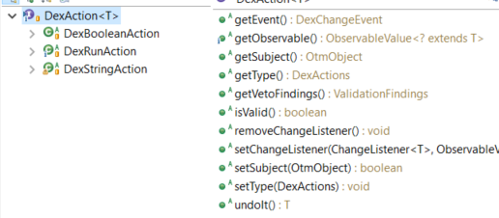
Action Manager Design
Dex.controllers
Dex.actions
View Controller
Action Manager
Action (I) <T>
Row Factories
@FXML
Menus
Buttons
isEnabled()
Do()
Undo()
-- manage queue
*Action
Actions orchestrate changing the model
Enabled(), Do(), Undo()
Initiated by user
Throw events when complete
3 types of action managers
Read-only, Minor Version, Full
Model objects get their controlling manager from model manager
DexAction implementors
Perform business logic
DexActions enumerates actions
Provides class information for instantiating specific actions
Architypes: Run, String, Boolean
doIt()
getSubject()
isAllowed()
isEnabled()
isValid()
undo()
Specific action enabled and run
model
OtmObject
Library Members
Get ActionMgr()
Model Manager
Read Only
Minor Version
Full
Action Manger selected based on Library and Object

Slide 8
Action Manager Usage
Dex.actions
Dex.controllers
Action Manager
Action (I) <T>
View Controller
Row Factories
@FXML
Menus
Buttons
isEnabled()
Do()
Undo()
-- manage queue
*Action
doIt()
getSubject()
isAllowed()
isEnabled()
isValid()
undo()
Specific action enabled and run
Enabled
Run
Undo
deleteItem.setDisable( !am.isEnabled(DexActions.DELETEPROPERTY, property ) );
model
OtmObject
// Controller Row Factory: Runs if menu item on a row is selected
private void changeAssignedType() {
OtmTypeUser user = (OtmTypeUser) getTreeItem().getObject();
user.getActionManager().run( DexActions.TYPECHANGE, user, null );
}
Library Members
Get ActionMgr()
Model Manager
Read Only
Minor Version
Full
modelMgr.getActionManager( true ).undo();
Action Manger selected based on Library and Object

Slide 9
Controllers
Controllers interact directly with JavaFX widgets.
Table and TreeTable controllers have:
RowFactories – describe view and formatting of each row including menus and actions
DAO (Data Access Objects) – maps Model Objects to row field values
Controllers are reusable.
Designed to have the exact same code used whereever needed.
Ex. MemberTreeTableController used in primary view and in type selection
Sub-types
Filter, Included, Main, Pop-up
Events - Implementors of OtmEventUser
Changes to the model are subscribed to by the controller
Events can be published for other controllers to respond to
Event publish and subscriptions registered in DexMainControllerBase

Slide 10
Building a new Dialog Menu
Clone an example controller from package org.opentravel.dex.controllers.popup;
Clone same example fxml file
Modify in Scene Builder
Change controller java class
Update controller fxml fields
Comment out/delete old business logic – just leave setup
Add init() and showAndWait() calls:
UnlockLibraryDialogContoller uldc = UnlockLibraryDialogContoller.init();
uldc.showAndWait( "" );
String remarks = uldc.getCommitRemarks();
Test
Create dialog JUNIT
Develop business logic and junit together

Slide 11
Events
Provide
Abstraction for activities that change the model.
Abstraction for activities that influence what should be displayed.
Isolation between controllers and other modules.
DexEvents
Layered on top of FX event architecture
FX events of type DexEvent are intercepted by DexEventDispatcher
Model manager is notified of Change events
Navigation events are added to the event queue
Registered EventHandlers receive events

Slide 12
Architecture Events
Main Controller
Window Controller
Tab Controller
getEventSubscriptionManager()
How to abstract which producers there are, and which events consumers want?
Each OtmEventUser has getters for published and subscribed events
register() controllers with the OTM Event Subscription Manager
When configured() the subscription manager uses setHandler() on each producer to set the consumer’s handlers for each event type
Result
Most event registration code abstracted into base classes
Configuration at startup –OR- when forced by a controller
Runtime events dispatched using FX framework
Event chains can span windows and applications that share access to the subscription manager
OTM Event Subscription Manager
Event Producer Controller (OtmEventUser)
setHandler()
Published map
Subscribed map
Register()
Configure()
Event Consumer Controller
(OtmEventUser)
eventHandler()

Slide 13
Event Architecture Set-up
Abstract Main Controller
Abstract Included Controller
addIncludedController()
-- add to event publishers map
-- add to event subscribers map
configureEventHandlers()
-- set handlers into publishers
Constructor(EventTypes[])
getPublishedEventTypes()
getSubscribedEventTypes()
setEventHandler()
eventHandler()
Included Controllers
Use super-type constructor that supports getting Generated and Subscribed Event Types
Set event handlers for published types
Each Publisher must set FX Node used to fire event
Event handler passes events to methods within controller
Main Controllers
Adding included controllers collects published and subscribed event types
After all controllers are collected, configures publishers with subscribers’ handlers
Concerns
Minimal code in controllers
Assure run only after all controllers are initialized and included into controller lists
No Dex code in runtime path, only in setup and configuration
Loops – event triggering 2nd event triggers event
Main Controller
Event Producer Controller
EventPublisherNode
Tab Controller
Fire
Dex Event
Window Controller
handler()
Event Consumer Controller

Slide 14
Event Architecture Runtime
Event Source
Approach: leverage and extend JavaFX event architecture.
Events provide the ability to loosely couple the interaction between two or more controllers
Dispatcher passes events to Event Handler in consumers
Each JavaFX node is associated with a dispatcher
Menu bar controller intercepts dispatch chain for debugging
node.setHandler()
fx:node
node.fireEvent()
DexEvent
Dispatcher
Event consumer
handler()
Event consumer
handler()

Slide 15
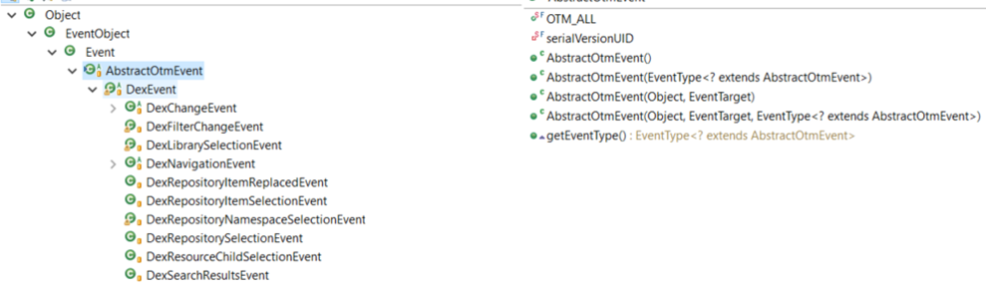
Event Architecture Implementation
Publisher
Define Published events array
private static final EventType[] publishedEvents = { DexMemberSelectionEvent.MEMBER_SELECTED };
Add published events array to constructor
super(subscribedEvents, publishedEvents);
Set event Publisher Node in configure()
eventPublisherNode = memberTreeController;
Fire event
eventPublisherNode.fireEvent(new DexMemberSelectionEvent(this, item));
Can be fired from handlers that have access to this controller via the super-type.
Consumer
Define subscribed events array
private static final EventType[] subscribedEvents = { DexFilterChangeEvent.FILTER_CHANGED };
Add subscribed events to constructor
super(subscribedEvents, publishedEvents);
Create event handlers
public void handleEvent(Event event) {}
private void handleEvent(DexMemberSelectionEvent event) {}
Create ignoreEvent Boolean if needed to protect from loops

Slide 16
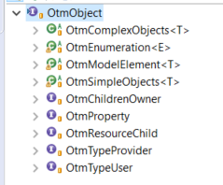
Model - Overview
The DEX OtmObject model:
Provides façade to the compiler’s TL model
Provides façade to JavaFX widgets
Encapsulate all model changes
Creates and maintains aggregates needed for displays
Makes extensive use of stereotypes and stereotyped behavior
Linked to Each TL model object
via a listener on the TL object
A map in the OtmModelMembersManager

Slide 17
OTM Object Model – JavaFX Properties
OtmObjects are facades on the existing TLModel
OtmObjects contain FX properties because
This is an FX application
Tables and FX containers need an observable property
If not added to the OtmObject then each user of that data would have to create a separate property
The contained observables will ensure integrity across FX application
Requires objects to “refresh” the FX properties when the object changes
Benefits overrides concern that doing so invades model with view semantics (MVC)

Slide 18
Otm Object Model - Children
Children
childrenOwner.modelChildren() – adds children from the TL object
Lazy evaluation – run when children is null
Inherited children
Children of an inherited facet are copies
Contextual facets are NOT children
Their related contributed facet (whereContributed) are children
Children Hierarchy
List of children organized by inheritance
Used in member properties view
Contents of childrenHierarchy
BO – just ID facet and aliases
Choice – just Shared and aliases
Core – Summary and aliases
ID Facet – inherited, children, summary facet
Shared Facet –
Children and inherited, children
parent’s choice, contributed, and inherited facets
Summary Facet –
Children and inherited children
parent’s detail, contributed and inherited facets

Slide 19
Otm Object Model – Inherited Properties
Children are OtmProperties
add children to the parent object
childrenOwner.modelChildren()
Properties need to know if they are inherited without knowing the context.
isEditable() needs to know if inherited
isInherited() not isInheritedBy(owner)
Inherited children
New OtmProperty object
Shared TL Object
isInherited()
return getTL().getOwner() != parent.getTL();
Base Object
Extended Object
TL
TL
Base Facet
Extended Facet
TL
TL
Base Property
Inherited Property
Parent
TL Object
Owner
Parent
TL Object
TL

Slide 20
Otm Object Model – Contextual Facets
Contextual facets:
Are library members (extends Library Member).
Are never inherited.
Are never children of objects or facets.
Have children and inherited children.
Are Property Owners.
Contributed facets:
Are facets (extends Facet)
Maintains relationship between contextual facet and object where injected.
Expose a façade for the contextual facet’s children.
Are the only inherited facet
Overrides AbstractFacet.isInherited()
Return getContributor().getWhereContributed() != this;
When Inherited
New contributed facet
Contextual facet has no knowledge of the inheritance
Base Object
Extended Object
Children
TL
TL
Contributed Facet
Contributed Facet
Parent
Contributor
Contextual Facet
Owning Entity
Where Contributed
Children
Inherited Children
TL
Property
Property
Property

Slide 22
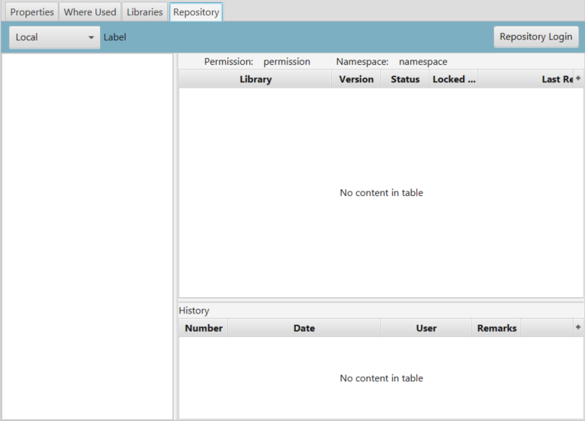
Repository Views
repository
Repository Selection Controller
Repository Login Dialog Controller
Configure(DexMainController)
Post(RepositoryManager)
Abstract Main Window Controller
Repository Namespaces Tree Controller
getRepositoryManager()
Object Editor App
Dex Main Controller
Configure(DexMainController)
Post(Repository)
Main()
getRepositoryManager()
Namespace Libraries Tree Table Controller
Repository Item Commit Histories Controller
ObjectEditorController
Configure(DexMainController)
Post(NamespacesDAO)
Post(RepoItemDAO)
super.getRepositoryManager()
NamespacesDAO
RepoItemDAO
RepoItemCommitDAO

Slide 23
DexFileHandler
fileChooser() – user selects single File
getProjectList() – list of File from passed directory
openProject() – use ProjectManager to open project File with findings and monitor
Dex.controllers
MenuBarWithProject Controller
Dex File Handler
@FXML
projectComboSelectionListener()
handleOpenMenu()
openFile()
Maps
fileChooser()
getProjectList()
openProject()
openFile()
fileChooser()
openProject()
Dex.tasks
Open Project File Task
Add(ProjectMgr)
Model Manager

Slide 24
Graphics (under controllers)
Sprites – moveable graphic entities
their own canvas
graphics context
Connections
Rectangles
Collapsable (FR)
Clickable (CR)

Slide 25
Domain Sprite
GraphicsCanvasController
Domain sprite
DomainProvidersCR
DomainUsersCR
subDomainRectangle
libraryFacetRectangle
Connect(domain sprite)
Sprite Manager
Column Rectangles
Active Sprites
otmDomain
getProviderDomains()
Providers sprite
getProvidersMap()
DomainProviderFR
Library + member list
OTM Model Manager
LibraryAndProvidersFR
ProviderCR

Slide 26
Adding to Launcher application
DONE - hook up to the launcher
// 1. Create *ApplicationProvider class
// 1a. Create Images class for icon
// 2. Create resources/META-INF file
// 3. Add dependency to launcher pom.xml
// 3a. artifactId and version from its POM
// *** FIXME - this is wrong for repoViewer, project setup is wrong.
// 4. Add application display name to /ota2-app-launcher/src/main/resources/ota2-app-launcher.properties
//
// DONE - Implement (extend) AbstractMainWindowController
// Requires setStatusMessage(), xxx() methods
// TODO - preferences (improve as i use it)
// Uses java beans to read/write to file
// 1. Abstract User Settings class (application common)
// 1a. Add fields, getters, setters for app specific preferences
// 2. Add load to main controller initialize
// DONE - AbstractOtmApplication -
// DONE - AbstractMainWindowController

Slide 27
Architecture
A very interesting example of listeners:
https://www.programcreek.com/java-api-examples/?code=chilloutman/photo-flow/photo-flow-master/app/src/main/java/ch/zhaw/photoflow/controller/PhotoFlowController.java#

Slide 28
Resources
DexEditField - utilities

Slide 29
Actions Architecture
Actions are listeners used on FX Observables.
The OTM Model Manager and sub-types of OTM Model element facades associate Actions.
Concerns
How to prevent cascade when model triggers change?
Should actions throw events?
If so, how to register them?
Should actions notify users?

Slide 30
Naming Conventions
Classes
<Subject><items><viewType>
Subject – the input to the controller providing the domain of the items.
If Model or Repository manager it is left off.
Controller
Controller fx:id
Containers in controller
Subject/predicate is the model manager
LibrariesTreeTableController
<VBox fx:id="libraries"
<TreeTableView fx:id="librariesTreeTable"

Slide 31
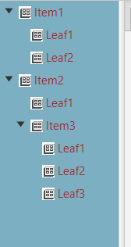
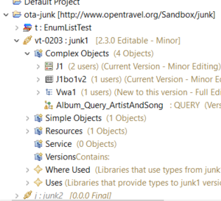
Overall Layout and Scenes
Navigator – how to simplify?

Slide 32

Navigator - how to simplify
Projects
Libraries
Chains
Named Objects
Where used
Uses
Properties *
Status/Decoration
Do we need folders for complex, simple service, resource?
Can projects be in a tab?
Only current project in tree
Objects from other projects available in selection wizards
Do we need library in tree view?
Just all active objects
New object selects which library
Menu/radio buttons for simple/complex/resource/svc
Filters
Library
Name match

Slide 33
Editors
Object
Just edit objects in a project
Resource
Just edit resources in a project
Service
Project
Create projects
Has repository pane

